Slide 1

AgentTwinDefect AI: An Agentic Digital Twin Platform for Real-Time Hidden Defect Prediction in Smart Manufacturing
SOA Project Review-1
Thursday, August 19th, 2026
 | Under the Guidance of Dr. Srikanth Cherukuvada Assistant Professor, Department of Computer Science and Engineering, KLH CSE Bowrampet Campus
Team Members K.AMULYA – 2420090132 P.SAHASRA – 2420090128 S.SUSHMITA – 2420090076

Slide 2
Outline of Research Work
Focus
Introduction
Literature Survey
Challenges
Research Objectives
Conclusion & Future Work
References

Slide 3
Problem Statement
Current manufacturing systems detect defects late, causing waste, rework, and downtime. Digital Twin and AI tools help with monitoring and prediction, but they rarely combine real-time defect prediction, root-cause analysis, and corrective-action selection.
AgentTwinDefect AI solves this by using an agentic Digital Twin that continuously monitors data, predicts defects, investigates causes, and recommends the best corrective action.

Slide 4
Objectives
Develop a Digital Twin of a manufacturing process for real-time monitoring.
Collect and process sensor/process data such as temperature, vibration, speed and pressure.
Predict emerging/hidden defects using ML models.
Deploy AI agents for defect analysis and root-cause identification.
Simulate corrective actions using the Digital Twin.
Recommend the best corrective action based on predicted outcomes.
Provide a real-time dashboard for monitoring, alerts and explanations.

Slide 5
Literature Survey
Authors | Title of the Paper | Methodology | Inferences | Limitation/Future work
Dai et al. (2025) | Generative and Predictive AI for Digital Twin Systems in Manufacturing | AI-enabled DT using Generative AI + Predictive AI; sensor-based defect prediction in welding | Enables proactive defect detection, predictive quality and virtual testing | Agentic AI, explainability and context-aware AI are proposed mainly as future extensions; implementation is partial.
Collao et al. (2025) | An Agentic AI-based Architecture for Digital Twins Specialized in Predictive Maintenance | Digital Twin + anomaly detection + multi-agent system with PdM and QA agents | Agents can detect abnormal behaviour and evaluate parameter changes | Highlights unresolved data quality, system integration and real-time responsiveness challenges.
Ullah et al. (2025) | Transforming Manufacturing Quality Management with Cognitive Twins: A Data-Driven, Predictive Approach to Real-Time Optimization of Quality | Cognitive Twin + ML + real-time manufacturing quality data | Improved quality, reduced defects/scrap and enabled proactive quality management | Existing predictive approaches still have limited adaptability to changing production conditions.
Alfattani & Hotami (2026) | Digital Twin-driven Multiscale Modelling for Real-Time Defect Prediction in Metal Additive Manufacturing | DT + PINN + CNN-LSTM + IoT + edge/fog/cloud | Achieved real-time defect prediction for LPBF with high detection performance | Validation is focused on LPBF, and the approach is computationally complex; agent-based reasoning is not incorporated.

Slide 6
Research Gap Identification
Existing Digital Twin systems can predict defects, but often lack autonomous reasoning for determining why the defect may occur.
Existing Agentic Digital Twin research focuses more on predictive maintenance/equipment behaviour than hidden product-defect prediction.
Current approaches have challenges in real-time integration, adaptability and data quality.
There is limited end-to-end integration of defect prediction → root-cause analysis → virtual corrective-action testing → decision recommendation.
Gap: There is a need for an adaptive agentic Digital Twin that not only predicts emerging product defects but also reasons about their causes and evaluates corrective actions in real time.

Slide 7
Innovation, Creativity, and Novelty
Agentic Closed-Loop Quality Intelligence
Our novelty is not simply "AI + Digital Twin."
Monitor → Predict → Diagnose → Simulate → Recommend
Predict: ML identifies potential hidden defect.
Diagnose: AI agent determines probable root cause.
Simulate: Digital Twin tests possible corrective actions.
Recommend: Decision agent selects the most suitable action.
Adapt: System learns from subsequent process outcomes.

Slide 8
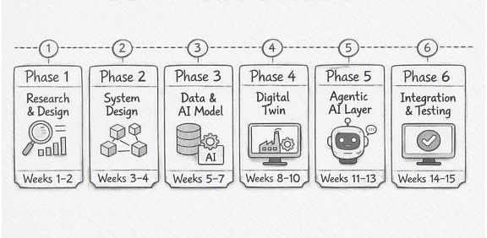
Feasibility and Project Plan
CHART FOR EACH PHASE OF YOUR PROJECT SHOULD BE THERE

